Slide 1
Bank Customers and Attrition
Ayo
Shola
Behrooz
12.12.2020

Slide 2
Problem
A manager at the bank is disturbed with more and more customers leaving their credit card services. They would really appreciate if one could predict for them who is gonna get churned so they can proactively go to the customer to provide them better services and turn customers' decisions in the opposite direction.

Slide 3
Objective
The objective is to find out the main reasons of attrition.

Slide 4
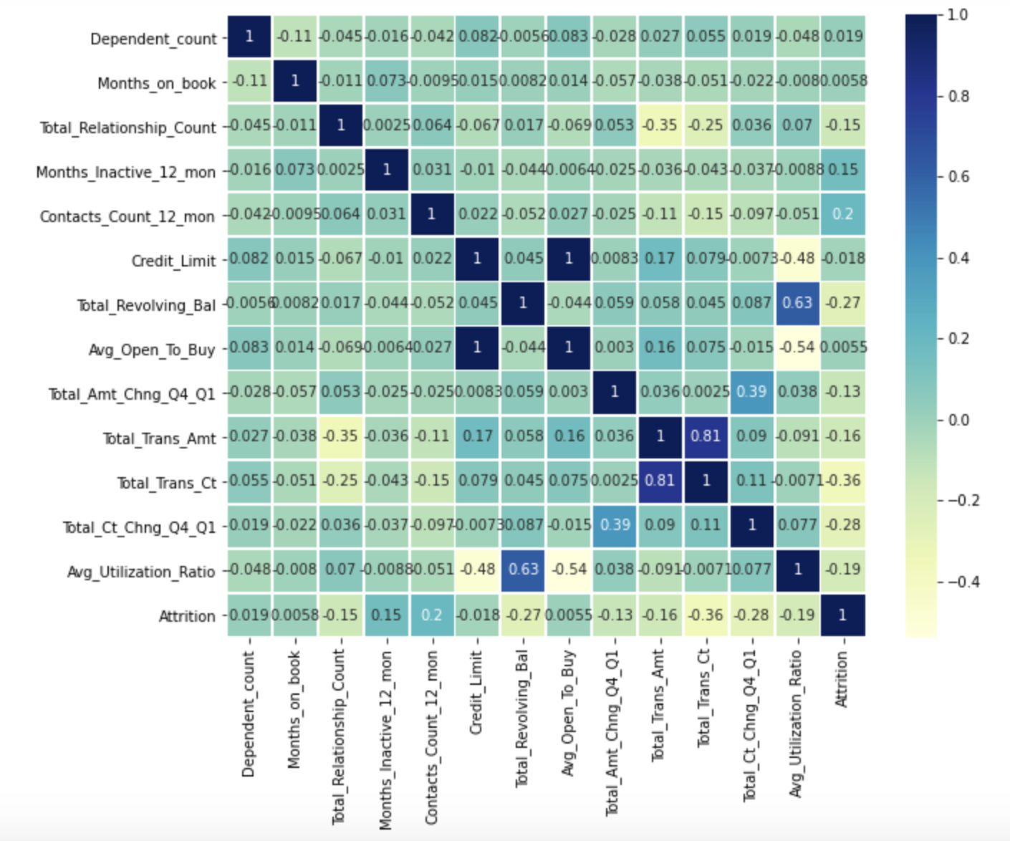
Heatmap of the Data Frame

Slide 5
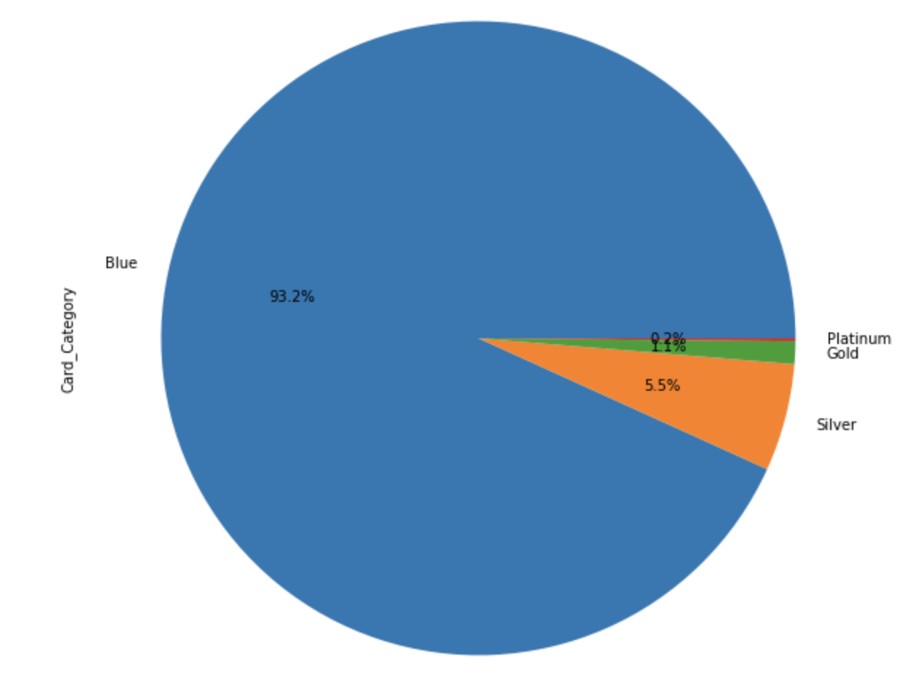
Pie chart: Card Category

Slide 6
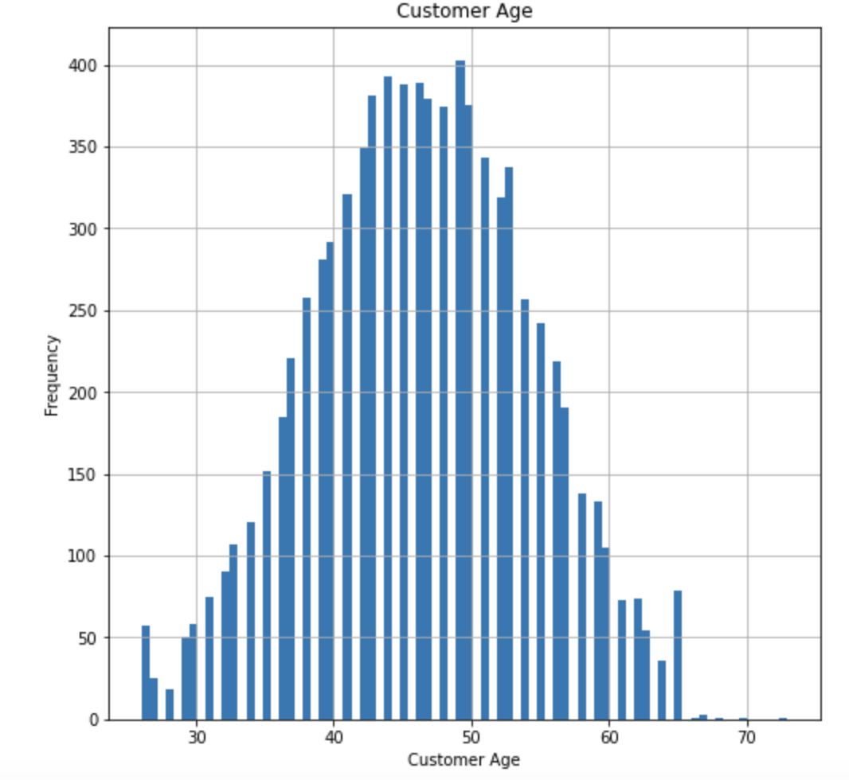
Age distribution of customers

Slide 7
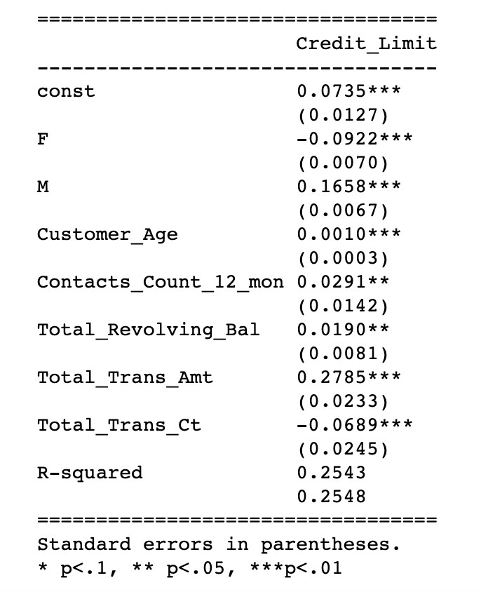
This is just a simple OLS regression, DV= Credit Limit R² – 0.255

Slide 8
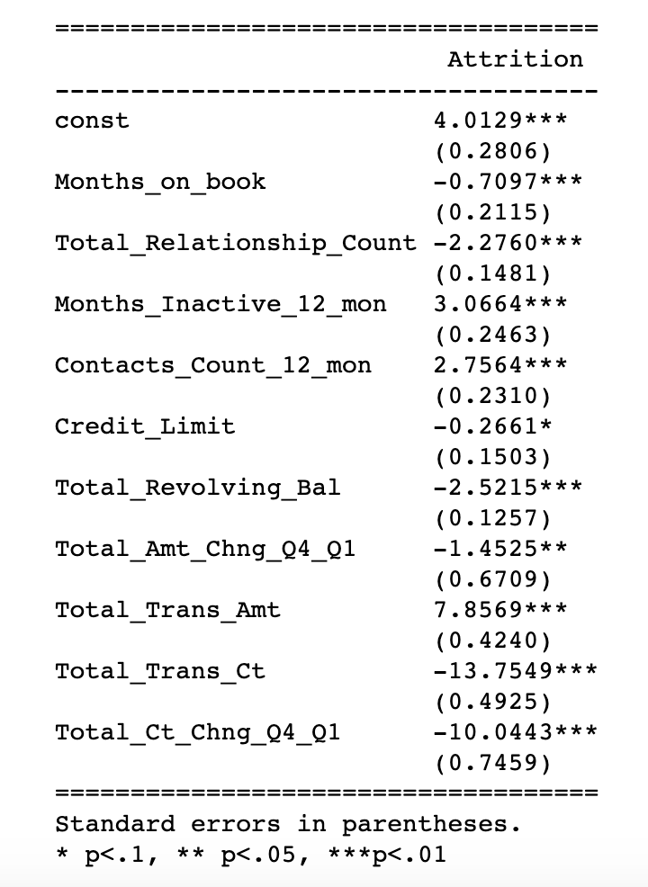
We estimated several Logistic Regressions to get the regression with the most significant variables
Logistic Regression DV= Attrition R² =0.4403

Slide 9
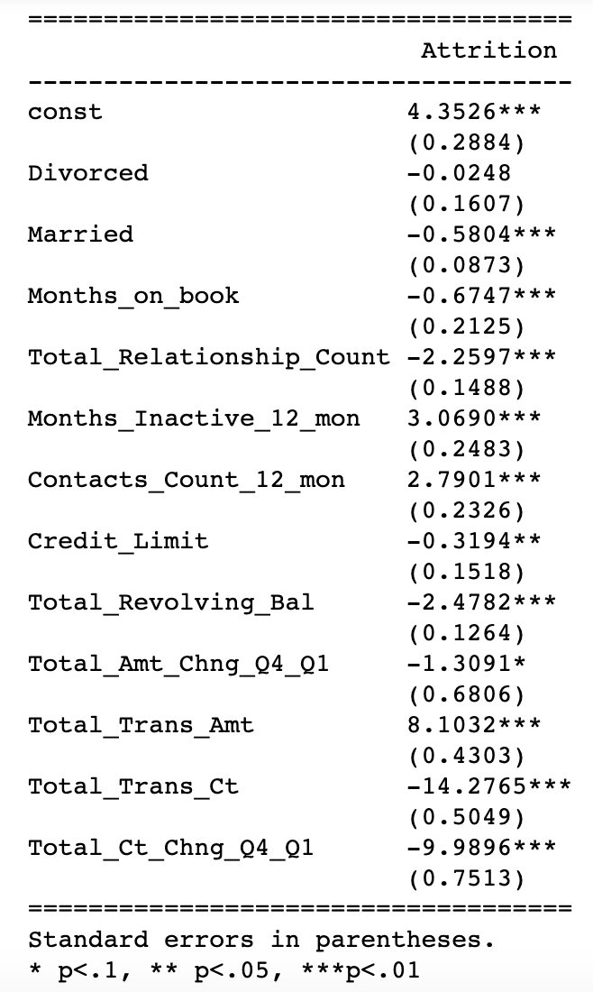
R² = 0.4469 Logistic Regression: Marital status as Dummy Variable: 1- When the categorical variable (Divorced) is not significant, it means that the impact of 'Divorced' is not different from the impact of the base variable (single). 2- 'Married' category is significant and the coefficient sign is negative. It means that the 'Married' group is less likely to churn as compared to the 'single' group.

Slide 10
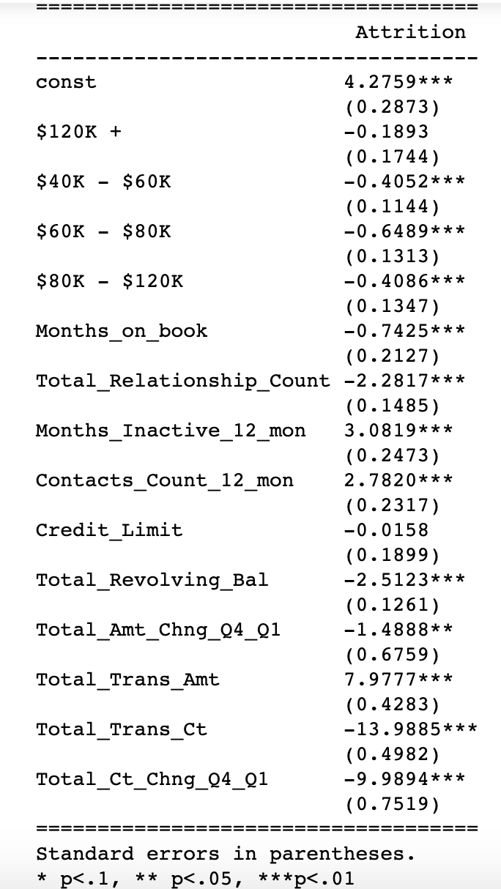

R² = 0.4447 Logistic Regression: Income category as Dummy Variable: Here the '40-60k', '60k - 80k', and '80k - 120k' categories are significant and negative, it means that these categories are less likely to churn as compared to the base category of 'less than 40k'. The impact of the '120k+' category is not significant, it means that there is no difference between the impact of '120k+' group and the impact of the base group (less than 40k).

Slide 11
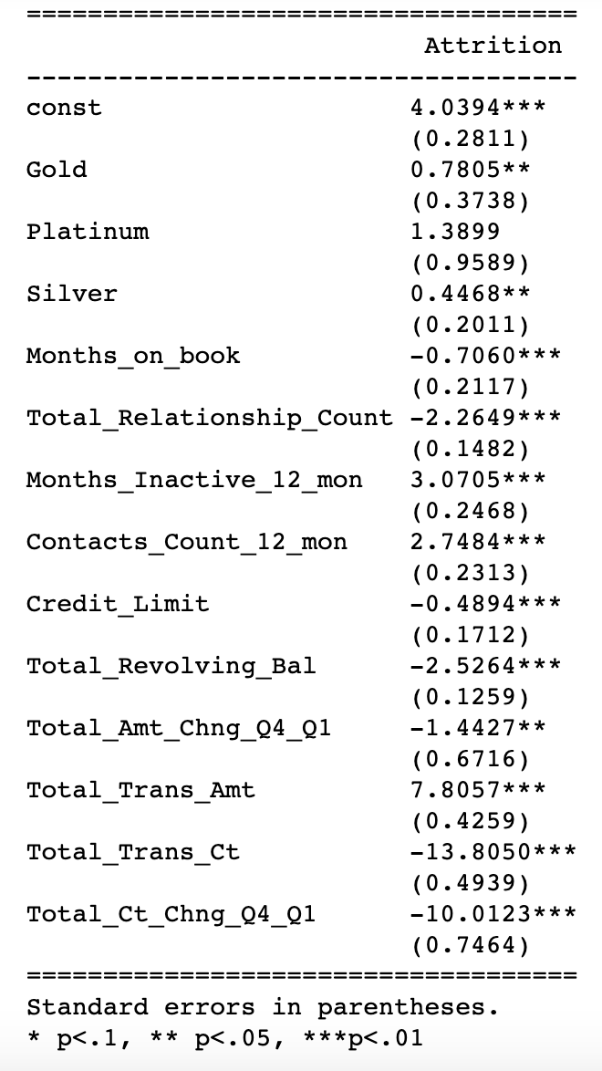

R² = 0.4416 Logistic Regression: Card category as Dummy Variable: The categorical variables of 'Gold' and 'Silver' are significant with positive coefficients. It means that these type of card holders are more likely to churn as compared to the 'Blue' card holders.

Slide 12
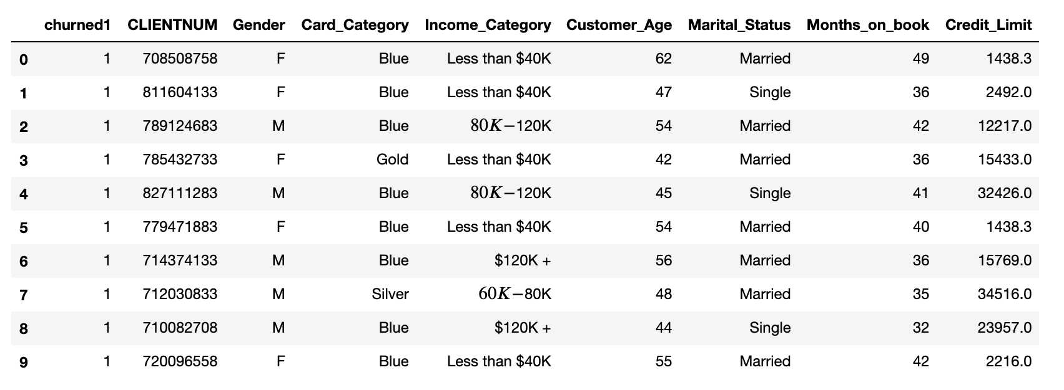
At this point we are interested to predict the number of customers who churned when the income categories are used
We predicted that 11.87% will churn

Slide 13
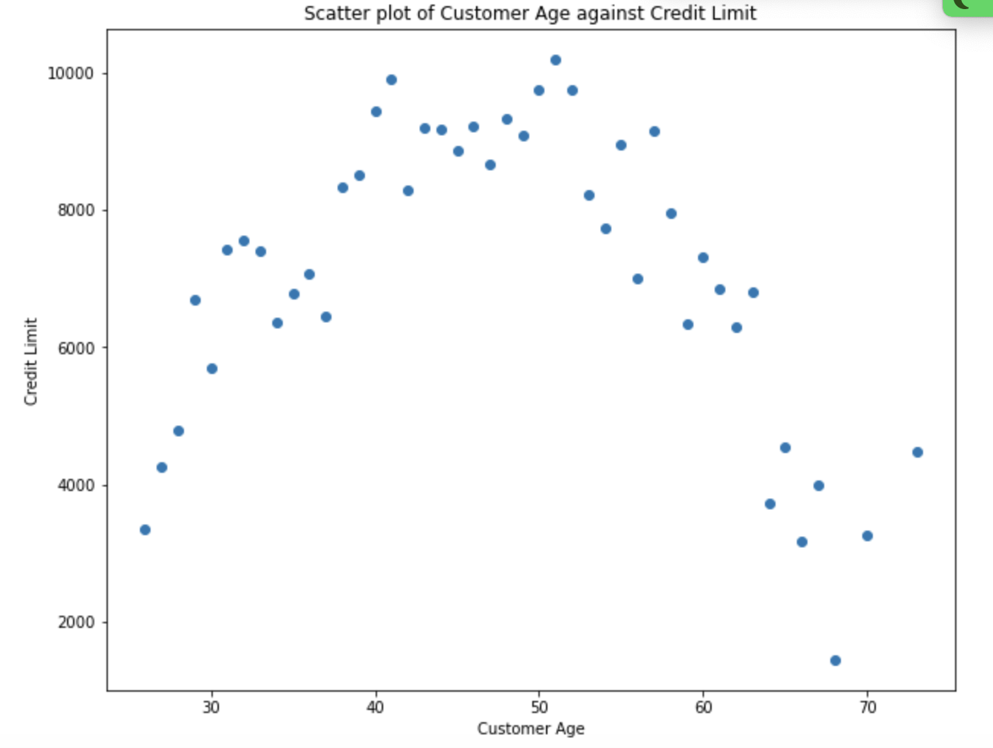
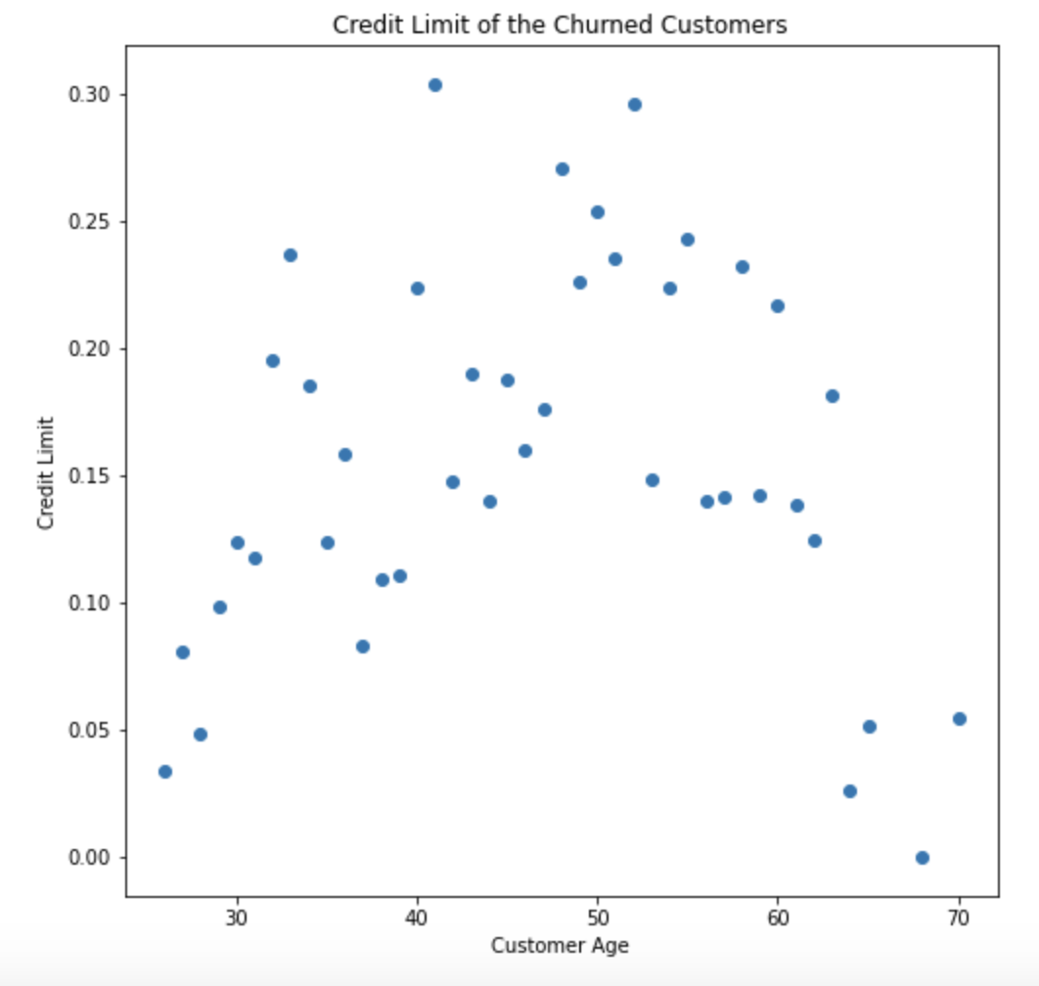
Age and Credit Limit: original data set. 8348 customers
Age and Credit limit:
Predicted Churned customers.
991 customers

Slide 14

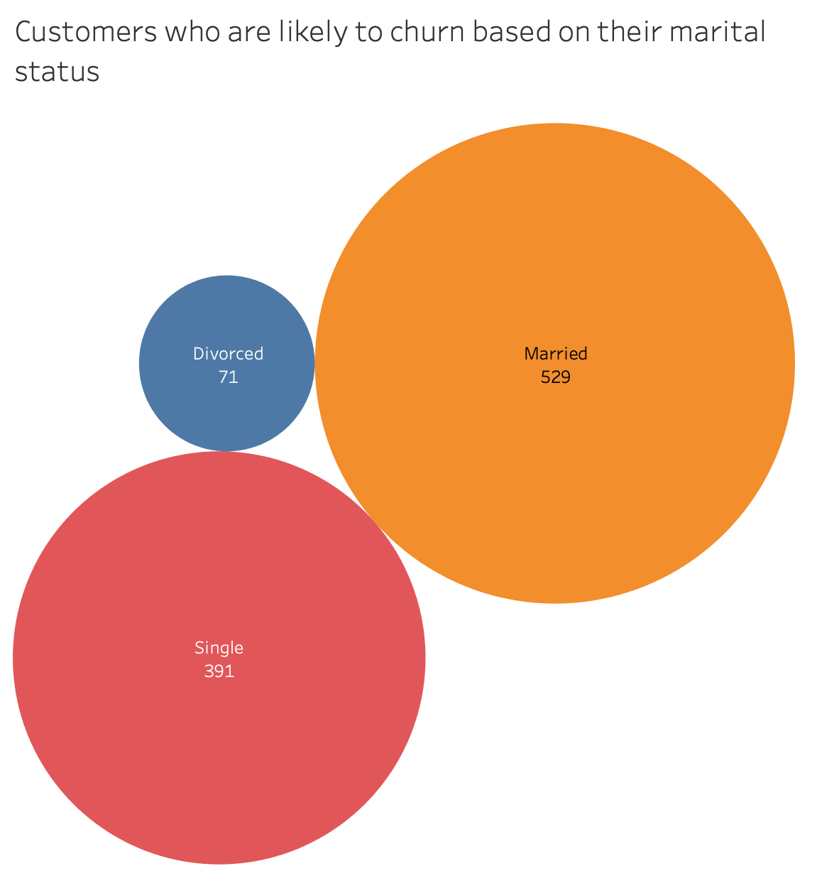
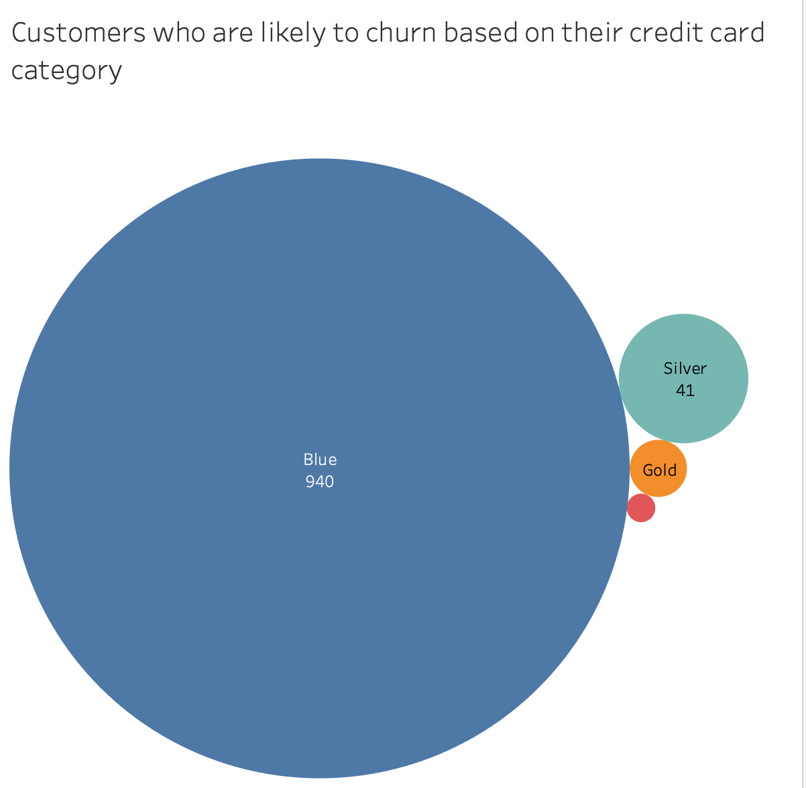
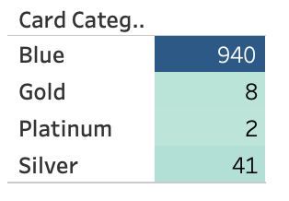
Prediction results

